Slide 1
Hydro Reach
Guide:
Mr: Eldhose K Paul
Assistant Professor Praveena Prakash
Dept of Computer Applications Roll No:42
S3 MCA
Date of Review:14/07/2025

Slide 2
Table of content
1.Introduction 11.System Architecture
2.Abstract 12.Demo Video
3.Scope&Objective 13.Result.
4.Feasibility Study 14.Future Scope.
5.Problem Definition 15.Conclusion.
6.Exsting System 16.Reference
7.Literature Review
8.System Requirements
9. Modules of Proposed System
10.Diagrams

Slide 3
Introduction

Slide 4
Introduction
HydroReach is a smart, automated, web-based system designed to modernize and simplify water delivery. By integrating real-time water availability checks, online payments, tanker assignment, and live delivery tracking, HydroReach ensures a transparent, reliable, and efficient water supply chain.

Slide 5
Abstract

Slide 6
Abstract
Hydro Reach is a smart, automated web-based solution designed to manage water distribution efficiently in drought-prone or water-scarce regions
It involves three primary modules: Admin, User, and Driver. The Admin updates water availability and tanker logistics monthly. Users can request water, make payments, and track delivery status. The driver update the delivery status
The system ensures transparency, minimizes manual intervention, and facilitates prompt water delivery through intelligent resource assignment.

Slide 7
Scope &objectives

Slide 8
Scope
Automate the process of water request, approval, and delivery.
Enable secure online payments and automated approvals.
Support location-based tanker assignment for faster service.
Allow drivers to update delivery status and users to track orders live.
Maintain admin dashboards for stock monitoring, request approvals, and logistics management.
Provide real-time availability of water and tankers to users.

Slide 9
Objectives
To design a transparent, user-friendly system for water request and delivery.
To reduce manual dependency in allocation and approvals.
To ensure fair distribution of limited water resources.
To minimize delays and human errors in the water supply process.
To improve efficiency and customer satisfaction.

Slide 10
Feasibility study

Slide 11
Technical Feasibility
The Hydro Reach system is technically feasible as it uses widely adopted and reliable technologies such as Python, Django framework, HTML, CSS, JavaScript, and SQL databases. The system also integrates GPS-based live tracking and online payment gateways which are supported by standard APIs. Since most users and administrators have access to web browsers and mobile devices, the platform can be easily deployed without requiring specialized hardware. Furthermore, the system is scalable and modular, allowing for future enhancements such as IoT integration, mobile app development, and AI-based predictive analytics.

Slide 12
Economic Feasibility
Hydro Reach is cost-effective because it minimizes manual labor and reduces errors associated with traditional water delivery systems. The development cost includes software development, server hosting, and domain registration, which are relatively low compared to the benefits. The system also reduces operational costs for water suppliers by optimizing delivery routes, preventing overuse of resources, and ensuring timely payments. By improving efficiency and customer satisfaction, Hydro Reach can potentially increase revenue and reduce wastage.

Slide 13
Operational Feasibility
The system is operationally feasible as it simplifies the workflow for all stakeholders. Users can request water online and track deliveries in real time, administrators can manage stock, approve requests, and assign drivers efficiently, and drivers can access delivery details and update progress seamlessly. The interface is user-friendly, requiring minimal training, and the workflow aligns with existing water delivery processes, making it easy to adopt.

Slide 14
Social Feasibility
Hydro Reach has high social feasibility as it directly benefits communities by providing a transparent, reliable, and convenient water delivery system. It reduces waiting time, ensures timely service, and promotes digital literacy among users. By supporting smart city initiatives and sustainable resource management, it also contributes to broader societal goals such as environmental conservation and efficient urban utility management.

Slide 15
Existing System

Slide 16
Existing system
Manual request and approval process.
No proper tracking of deliveries.
Lack of stock availability checks.
Higher chances of human error.

Slide 17
Proposed system

Slide 18
proposed system
Automated stock checking before approval.
Online payment system for quick approvals.
Automatic tanker assignment.
User dashboard to track live status.

Slide 19
Literature review

Slide 20
Literature Review
Author | Year | Source | Title | Work Done By Key Features
Sharma, R. & Mehta, S. | 2020 | International Journal of Water Resources Development | Digital Solutions for Water Crisis in Rural India | Discusses how digital platforms can be used to manage water scarcity in rural regions, emphasizing mobile-based request systems.
Kim, J. & Lee, H. | 2021 | Sustainability (MDPI) | Smart Water Management using IoT and Cloud Computing | Explores the integration of IoT with cloud platforms to track water supply and consumption in real-time.

Slide 21
Literature Review
Author | Year | Source | Title | Work Done By Key Features
Nanduri, S. & Jain, A. | 2022 | IEEE Access | Design of Emergency Resource Allocation System using AI | Proposes an AI-based allocation system for emergency resources, including water, based on urgency and availability.
Ahmed, T. & Rahman, K. | 2023 | Journal of Environmental Management | Water Supply Chain Optimization in Drought-Prone Areas | Investigates strategies to optimize water delivery in drought-prone regions using predictive analytics.
Patel, V. & Kaur, M. | 2024 | Procedia Computer Science | Development of a Mobile App for Rural Water Delivery Requests | Presents the design and implementation of a mobile application that enables users to request water deliveries based on need.

Slide 22
System requirements

Slide 23
Hardware Requirements
Processor: Ryzen5 / AMD equivalent or higher
RAM: Minimum 4 GB (8 GB recommended)
Hard Disk: 250 GB or more
Display: 1024 × 768 resolution or higher
Network: Stable internet connection

Slide 24
Software Requirements
Operating System: Windows
Backend: Python (Django Framework)
Frontend: HTML, CSS, JavaScript
Database: MySQL / SQLite
Web Server: Apache / Nginx (or Django built-in server for testing)
Browser: Chrome / Edge / Firefox (latest versions)

Slide 25
MODULES OF PROPOSED SYSTEM

Slide 26
MODULES
ADMIN
Admin manages the entire system operations.
Updates water stock and monitors tanker availability.
Approves or rejects water requests based on stock and capacity.
Verifies user payment status after successful transactions.
Assigns tankers and drivers to deliver the approved orders.
Tracks delivery progress and maintains overall control.

Slide 27
User
Driver
Drivers can log in to view assigned deliveries from the admin.
Access user contact details and location for delivery.
Update delivery status during each stage (on the way, delivered, etc.).
Share live location to enable user tracking until delivery is complete.
Users can register/login to the system.
Submit water delivery requests specifying quantity, address, and date.
Receive notifications when requests are approved by the admin.
Complete payments securely through an integrated online payment gateway.
Access real-time tracking of their delivery through GPS updates.

Slide 28
Payment
Notification
Accepts multiple payment methods (UPI, Credit/Debit Card, Net Banking).
Admin can verify and update payment status.
Stores transaction details securely in the database
Driver shares real-time coordinates.
Users can monitor the delivery location and route on a map interface.
Admin can also view all ongoing deliveries.
Updates automatically when delivery is completed.

Slide 29
Diagrams

Slide 30
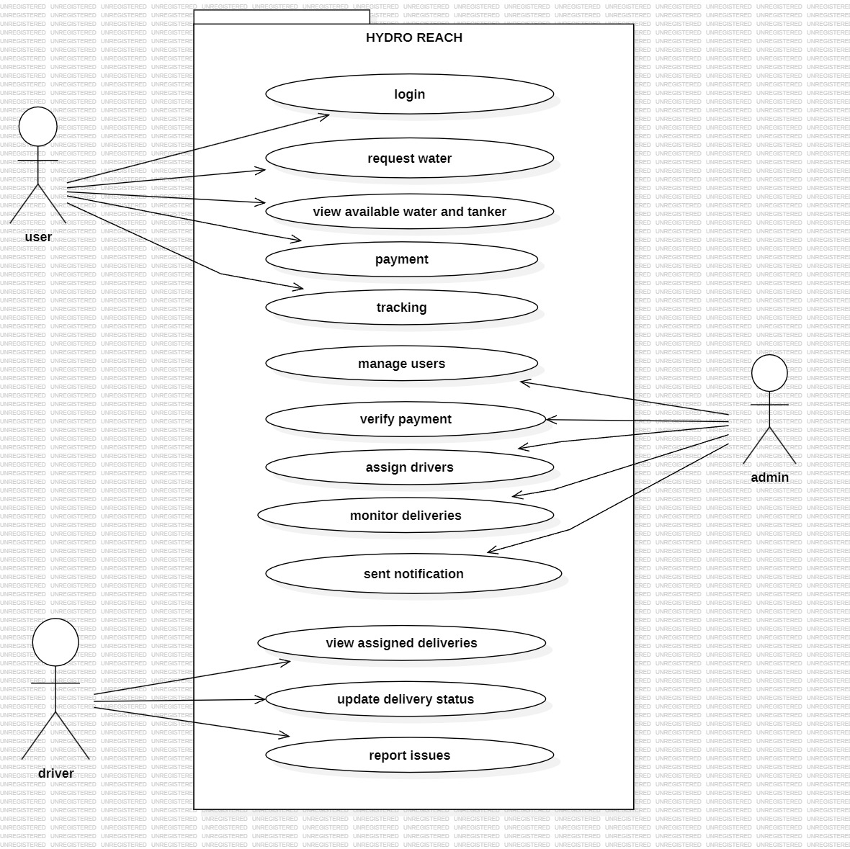
USECASE DIAGRAM

Slide 31
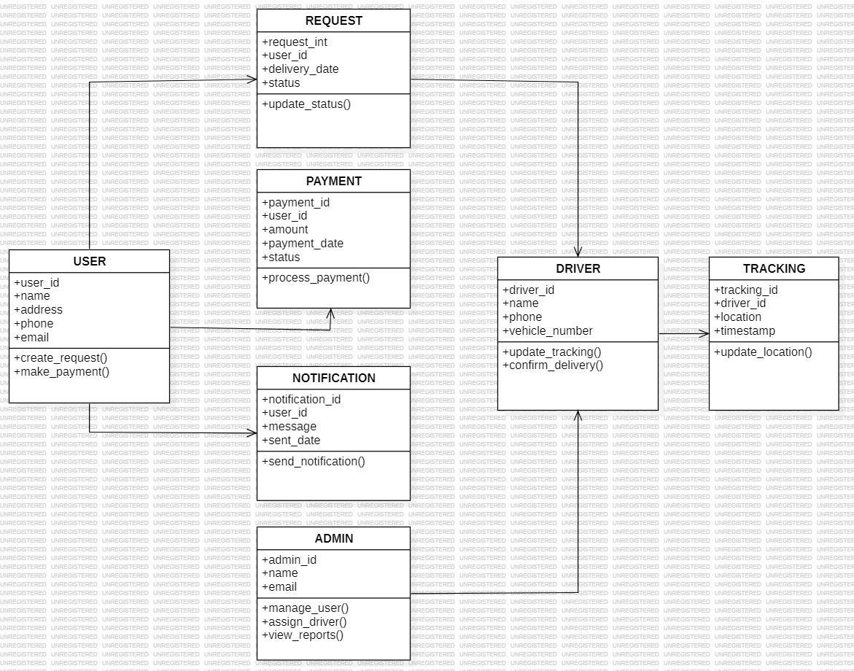
Class diagram

Slide 32
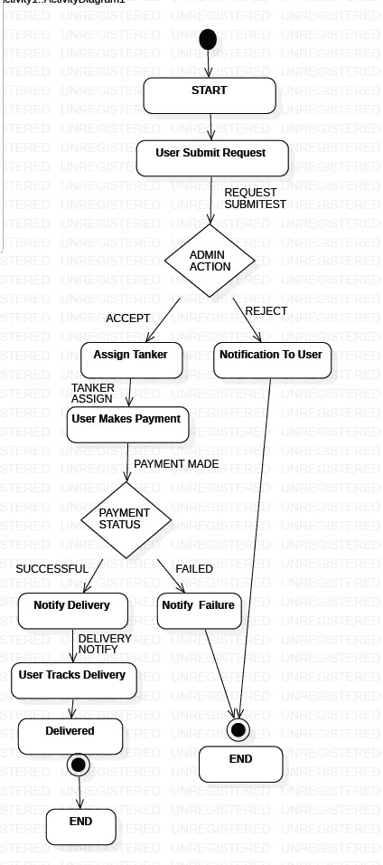
ACTIVITY DIAGRAM

Slide 33
DATA FLOW DIAGRAM(DFD)

Slide 34
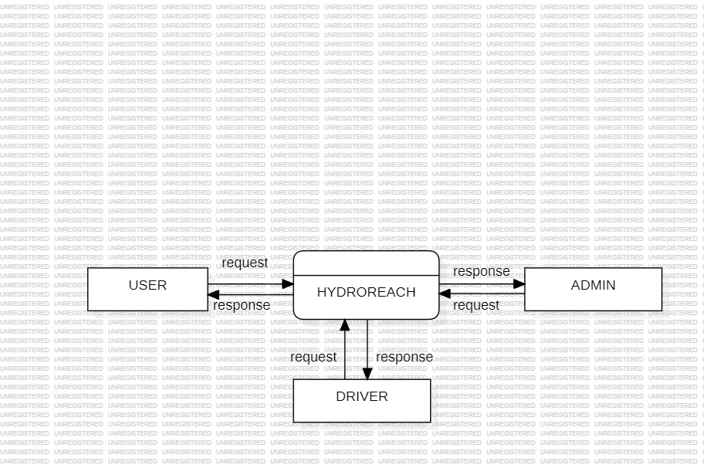
LEVEL 0

Slide 35
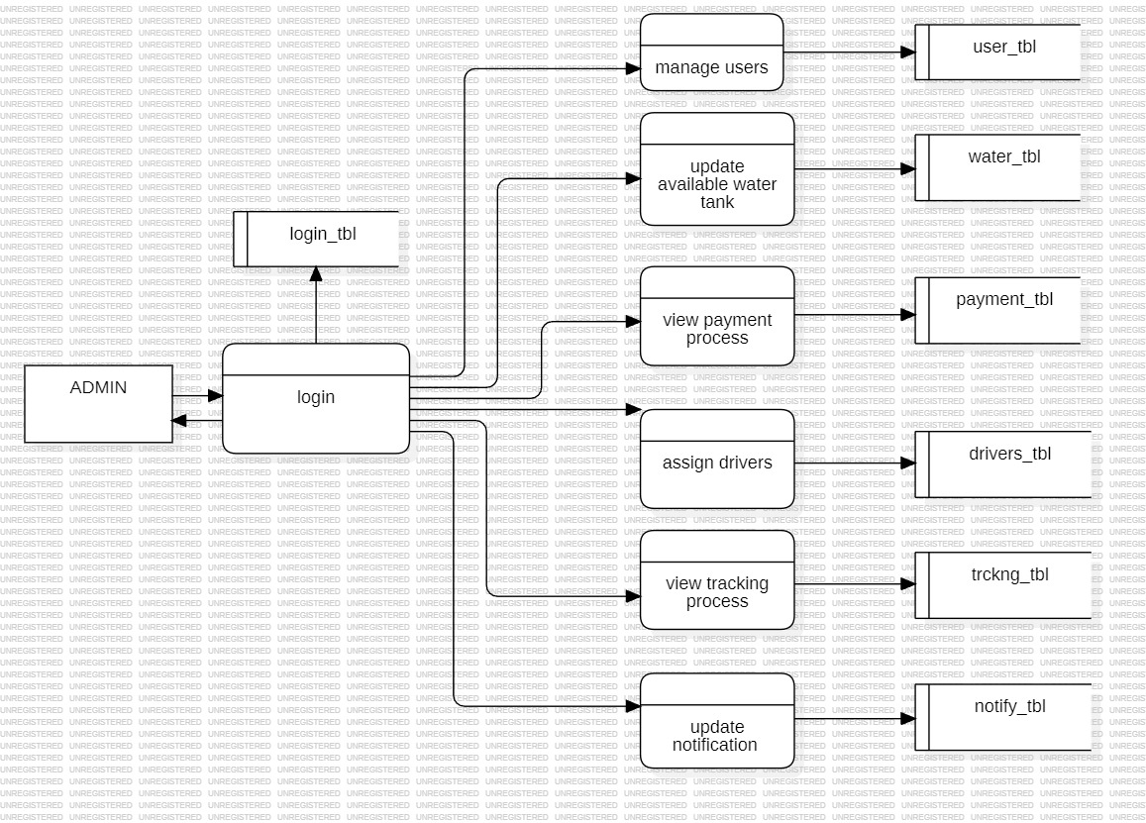
LEVEL 1
request
response

Slide 36
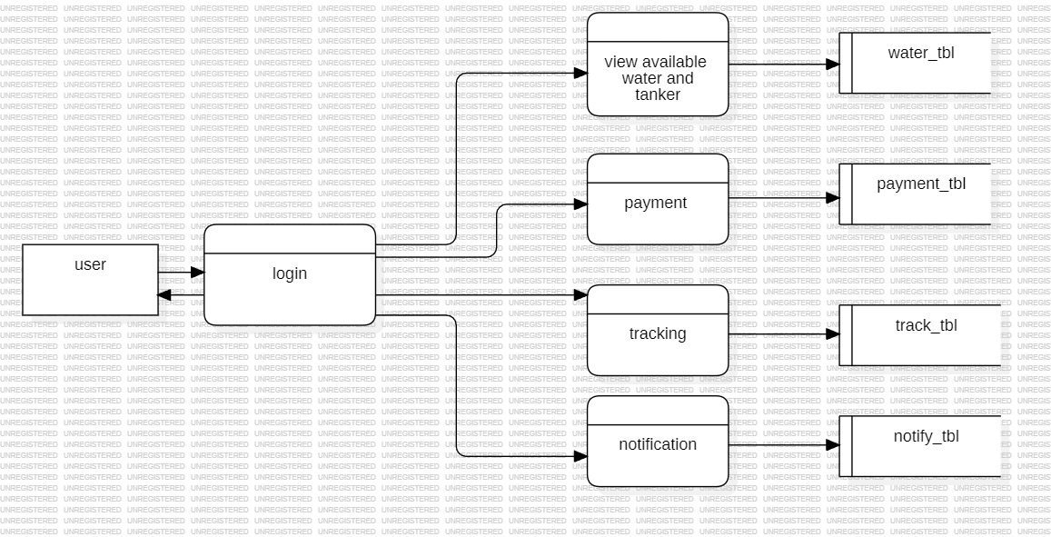
LEVEL 2
request
response

Slide 37
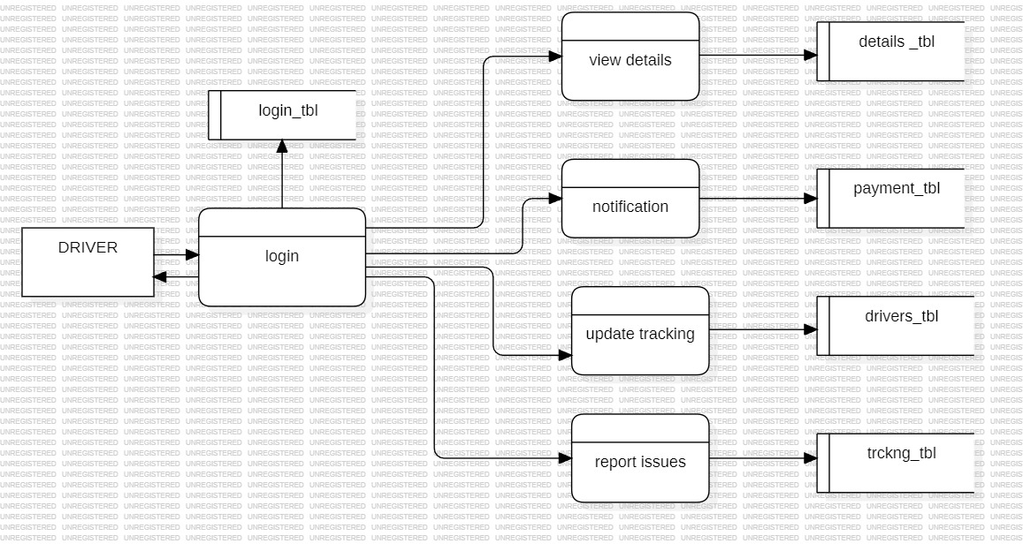
level3
request
response

Slide 38
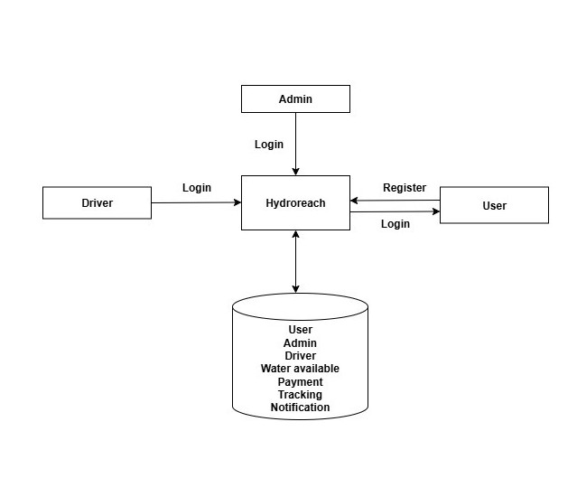
Systems architecture

Slide 39
result

Slide 40
Result
The Hydro Reach – Smart Water Delivery System successfully demonstrates the automation and digital management of water delivery services through a web-based platform. The following results were achieved after implementing the system:
Efficient Water Request Management: Users can now submit water requests online, eliminating the need for manual calls or in-person requests. Requests are automatically received by the admin, who can approve or reject them based on availability.
Real-Time Stock and Delivery Monitoring: Admins can update water stock and tanker availability in real time. Drivers receive delivery assignments instantly, ensuring timely and organized operations.

Slide 41
Secure Online Payments: Integration with an online payment gateway allows users to make secure digital payments. Admins can verify and record payments, improving transparency and reducing errors associated with cash transactions.
Live Delivery Tracking: GPS-based tracking enables users to monitor the exact location of tankers during delivery. This ensures transparency, reduces waiting times, and increases customer satisfaction.
Driver and Admin Coordination: Drivers receive accurate delivery details including customer address, contact information, and assigned tanker, while admins can monitor all ongoing deliveries efficiently
User-Friendly Interface: The system provides an intuitive interface for users, admins, and drivers, making it accessible even to users with minimal technical knowledge.
Operational Efficiency and Reduced Errors: Automation of request handling, payment verification, and delivery tracking reduces manual effort, errors, and delays compared to traditional water delivery methods.
Scalability and Future Expansion: The system is designed to be scalable, allowing future enhancements such as mobile app integration, IoT-based water level monitoring, and advanced reporting dashboards.

Slide 42
Future scope

Slide 43
Future scope
Develop a mobile application for users, drivers, and admins to access the system conveniently.
Integrate IoT-based water level sensors in tanks and tankers for real-time water stock monitoring.
Implement route optimization and predictive analytics to reduce delivery time and improve efficiency.
Add automated notifications (SMS/email) for users about request approval, payment, and delivery status.
Expand the system to multiple regions or cities for centralized water management.
Include eco-friendly and sustainable practices, like tracking water usage and optimizing tanker routes.
Introduce detailed reporting dashboards for admins to monitor deliveries, payments, and system performance.
Enable AI-based demand prediction for better resource planning and efficient water distribution.

Slide 44
Conclusion
The Hydro Reach – Smart Water Delivery System successfully automates and streamlines water delivery by integrating online requests, secure payments, and real-time GPS tracking. It improves efficiency, reduces manual errors, ensures timely deliveries, and enhances user satisfaction. The system’s scalable design allows future enhancements, making it a reliable and modern solution for smart and transparent water distribution.

Slide 45
Reference
Vidyadhara, M. V. (2024). Rural drinking water supply in India – An overview. International Journal of Creative Research Thoughts (IJCRT), 12(12), e270–e274.
R. K. Gupta and S. Kumar, “Web-Based Water Supply Management System: An Efficient Approach,” International Journal of Computer Applications, 2023.

Slide 46
Thank you

